Slide 1
ONLINE FLIGHT RESERVATION SYSTEM
P.V.Manvitha
192111208
CSE

Slide 2
OUTLINE
BACKGROUND OF STUDY
STATEMENT OF PROBLEM
OBJECTIVES
LITERATURE REVIEW
PROPOSED FRAMEWORK
RESULTS AND DISCUSSIONS
CONCLUSION
RESEARCH CONTRIBUTIONS

Slide 3

INTRODUCTION
Airline reservation systems were first introduced in the late 1950s as relatively simple standalone systems to control flight inventory, maintain flight schedules, seat assignments and aircraft loading.
Bookings through various channels such as airline websites, mobile apps, or third-party travel platforms
airline reservation system allows travelers to search for flights, compare prices, select seats, and make bookings through various channels such as airline websites, mobile apps, or third-party travel platforms.

Slide 4
BACKGROUND OF STUDY
This system is slow and results into booking conflicts, vacant seats in some planes and it is hard to quickly obtain customer information in case of emergency.
Flight booking is done through travel agents across major towns, flight data and customer details.
Comprehensive understanding of airline reservation systems and their significance in the aviation sector.

Slide 5
STATEMENT AND PROBLEM
The current system is manual, this system is slow, time consuming and it is very difficult for each person to book through office agents.
It is very difficult to calculate how many peoples registered and how many seats on a particular plane are vacant .
This requires quite a lot of time and wastage of money as it requires quite lot of manpower to do.

Slide 6
OBJECTIVES
The Airline Reservation System (ARS) serves as the backbone of the aviation industry, facilitating seamless booking processes for travelers worldwide.
The ARS streamlines the complex task of booking flights by integrating various functionalities, including ticket reservations, seat selection, payment processing, and itinerary management.
These innovations enable personalized recommendations, predictive pricing models, and proactive customer support, thereby enhancing user satisfaction and loyalty.

Slide 7
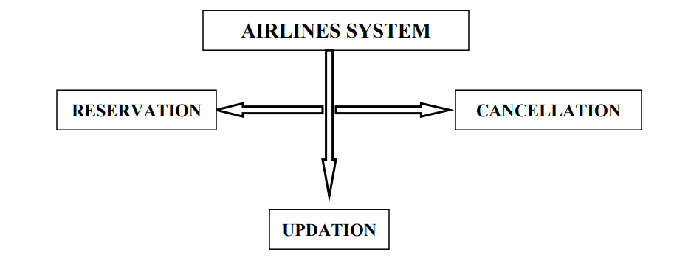
AIRLINE SYSTEM

Slide 8

LANGUAGES USING

Slide 9
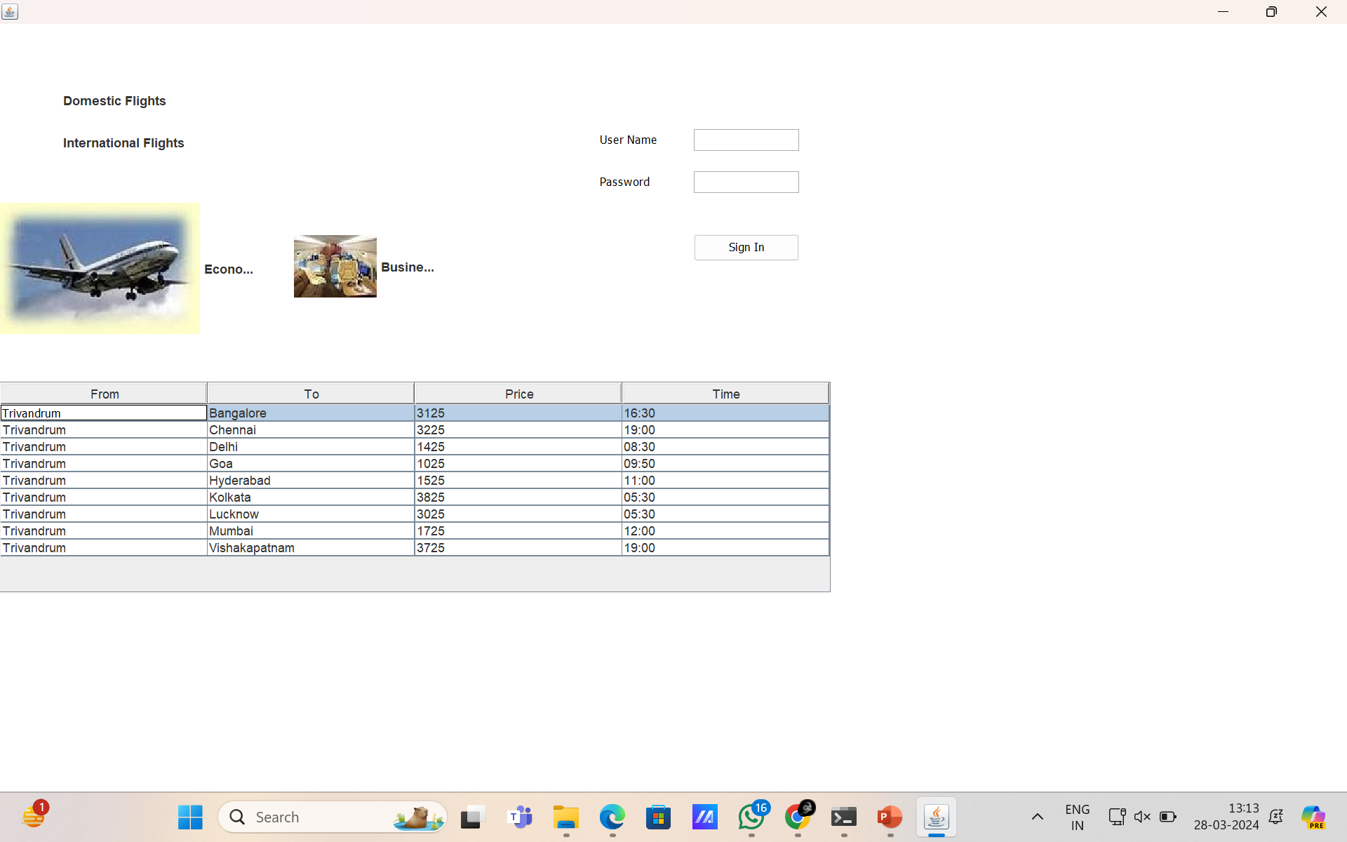
LOGIN DETAILS

Slide 10
CONCLUSION
In conclusion, the advent of online airline reservation systems has revolutionized the way people plan, book, and manage their air travel.
For passengers, online reservation systems provide a user-friendly platform to search for flights, compare prices, and make bookings from the comfort of their homes or on the go.
In essence, online airline reservation systems have transformed the way people travel, ushering in an era of convenience, accessibility, and connectivity.

Slide 11


